Slide 1


Big Data IN Telecom
Group 5:
Bhagyashree Soni
Kireet Bhardwaj
Vamsi Krishna
Suganth

Slide 2
Contents:
Problem Statement
Challenges and Learnings
Approach
Model Strategy
Insights and Recommendations
References

Slide 3
Problem Statement
Telecom network often encounters large number of tweets based on the user experience for a network. This huge amount of raw data can be used for industrial or business purpose by organizing according to our requirement and processing.
This project aims to address the social media review challenges for the telecom companies by extracting the tweets, analyzing them and segregating them into various categories to help the company understand the concerns of their customers and thereby, save millions and prevent customer churn.

Slide 4
Approach
Examining Large amount of Verizon page tweets extracted from Twitter for a period of 4 days using hashtag #Verizon.
Classifying the tweets into different labels based on the user experience for the network.
Analyzing the tweets based on categories and gaining insights from the data.
Performed visualization to better analyze the user experience.
Developing Model using Machine Learning algorithm to classify the tweets and evaluate the model.

Slide 5
Tweets Classification Category
Poor Service
Happy Customer
Churn/Lost Customer
Potential New Customer
Higher Price

Slide 6
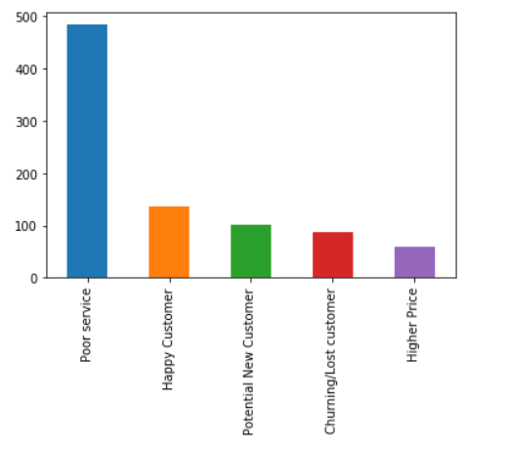
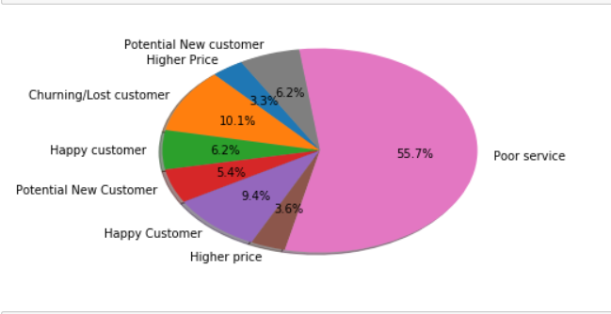
Exploratory Data Analysis
Count of Tweets under various category
Pie Chart to demonstrate the percentage of tweets under various category

Slide 7
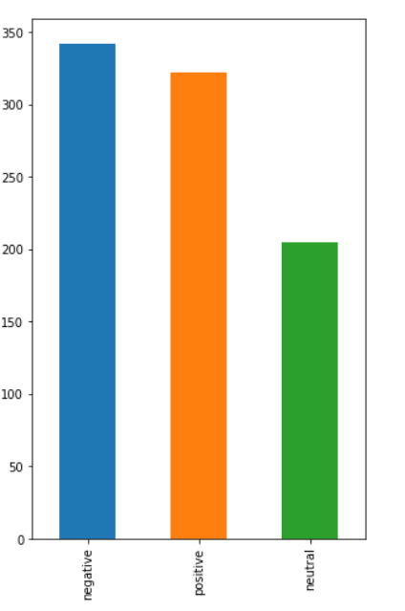
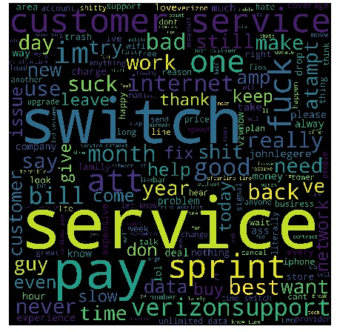
Word Cloud for the tweets
Sentiment Analysis

Slide 8
Data Cleaning
Converting the text to lower case.
Used regular expressions to remove punctuations from the tweets.
Tokenized the word, Removed the stop Words and performed Lemmatization.
Used TFIDF to perform feature vectorization method widely used in text mining to reflect the importance of a word to a text.

Slide 9
TFIDF – TERM FREQUENCY INVERSE DOCUMENT FREQUENCY
Term frequency-inverse document frequency (TF-IDF) is a feature vectorization method widely used in text mining to reflect the importance of a term to a document in the corpus.
Term frequency TF(t,d) is the number of times that term t appears in document d, while document frequency DF(t,D) is the number of documents that contains term t.
IDF measures how common a word is among all documents in blob list. The more common a word is, the lower its idf.
In the following code segment, we start with a set of sentences. We split each sentence into words using Tokenizer. For each sentence (bag of words), we use HashingTF to hash the sentence into a feature vector.
We use IDF to rescale the feature vectors; this generally improves performance when using text as features..Our feature vectors could then be passed to a learning algorithm.

Slide 10
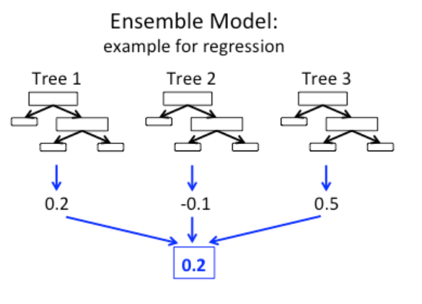
Model building and prediction using Pyspark Machine Learning.
We have implemented Random Forest model using Pyspark MLlib. The ensemble model makes predictions by combining results from the individual trees.
The model building involves ,splitting the data into training and test sets. Training data was created manually by tagging the tweets based on customer experience with n/w in mentioned five categories.
Fitting the model on training data.
Learn a model on test data, and predict the model and its test accuracy.

Slide 11
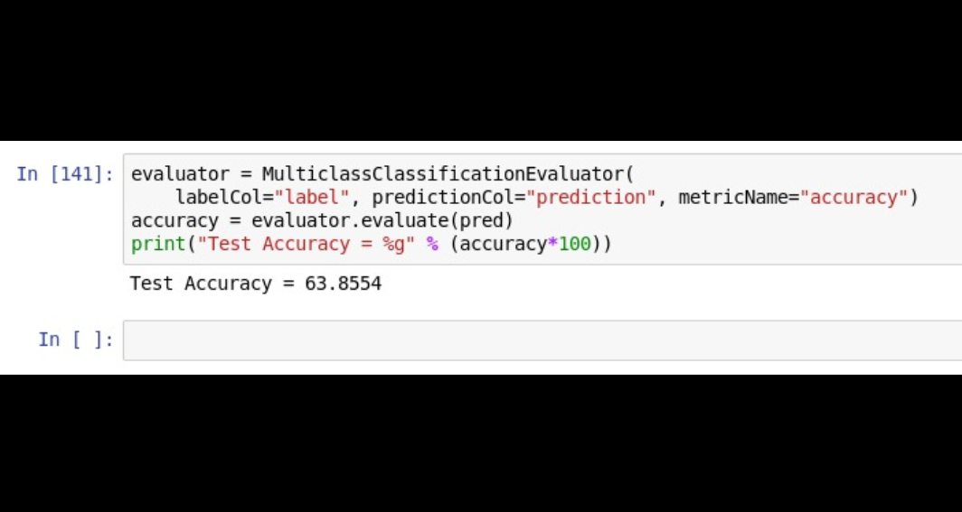
Model Accuracy and Evaluation
The model accuracy comes out to be 63.85%
Below is the screenshot for Model Accuracy.

Slide 12
Recommendations and Insights
From our analysis we can say that Verizon must focus on their service (which includes customer service and Network issues). By focusing on these issues they can improve their customer satisfaction and avoid churn( which is also visible in the plots)
We can also see around 12.5% of people are willing to join Verizon( New potential customers) They can use this information and make sure their marketing expenditure is used to attract these customers.
Use Real time tweets to analyze the problem with the Verizon network and can give a quick solution to the problem to avoid network traffic and give a quality service to the customer.
Location based data can be used to offer good deals to customers and design campaigns to combat churn.

